Slide 1
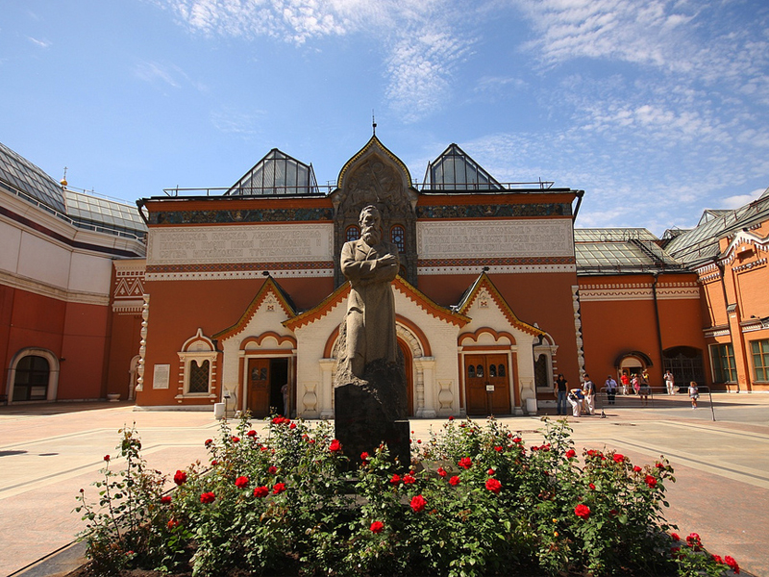
Tretyakov Gallery
Spotlight 9 Module 5 работа выполнена учителем английского языка МОБУ Никитинская СОШ Саракташского района Оренбургской области
Тукманбетовой Л.Р.

Slide 2
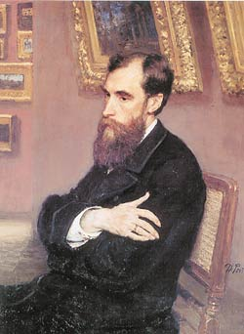
Pavel Mikhalovich Tretyakov
(1832-1898)
merchant, industrialist
In 1892 Tretyakov donated his
collection(1.287 paintings,
drawings, 5sculptures) to the city of
Moscow. The first works in his collection were the paintings of the “Peredvizhniki” .

Slide 3
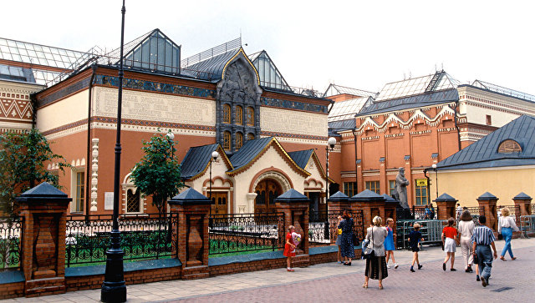
The gallery was founded in 1856. All the art inside the gallery includes 130000 works by Russian artists.

Slide 4
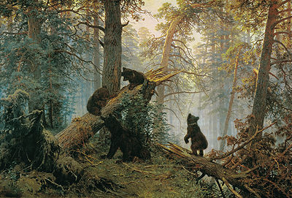
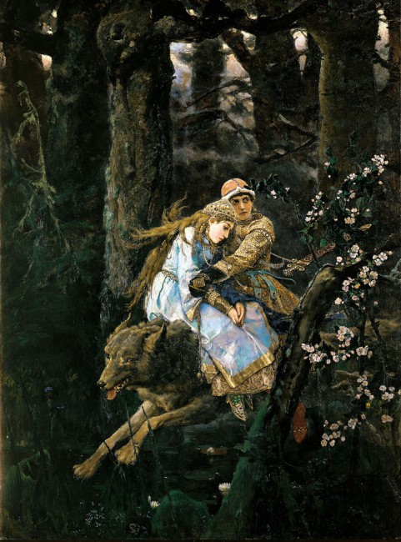
Ivan Shishkin “Morning in a Pine Wood”
Victor Vasnetsov
“Ivan Tsarevich on the Grey Wolf”
The first paintings bought by the collector.

Slide 5
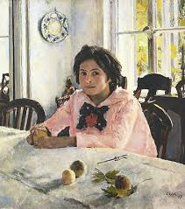
Valentin Serov “Girl with Peaches”

Slide 6
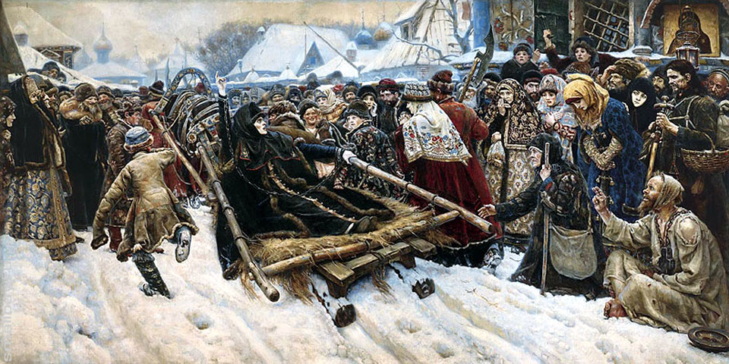
Vasily Surikov “Boyarynya Morozova”

Slide 7
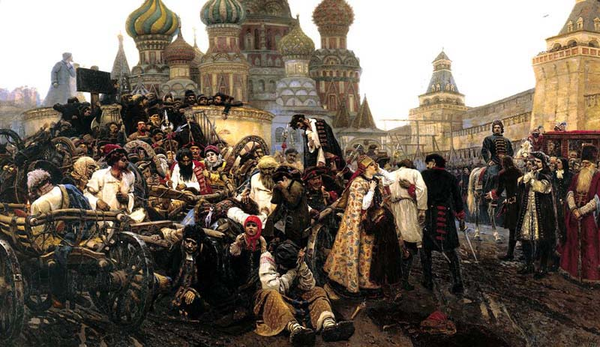
“The Morning of the Strelets Execution”

Slide 8
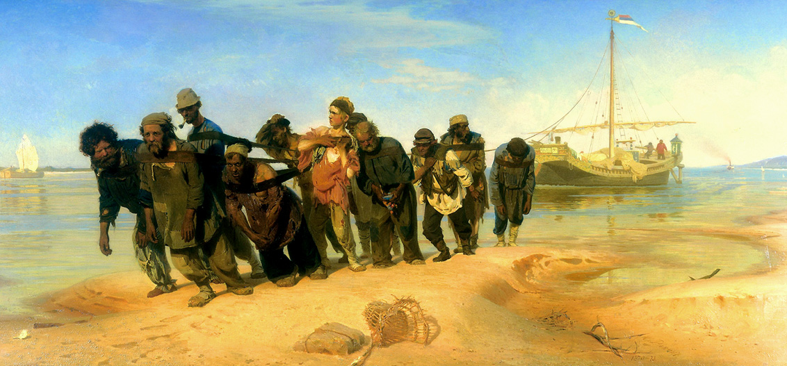
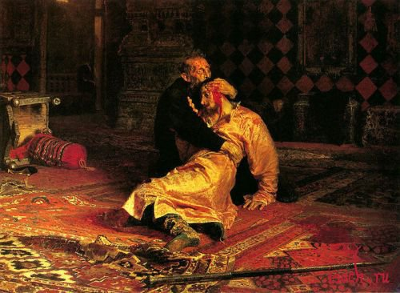
Ilya Repin

Slide 9
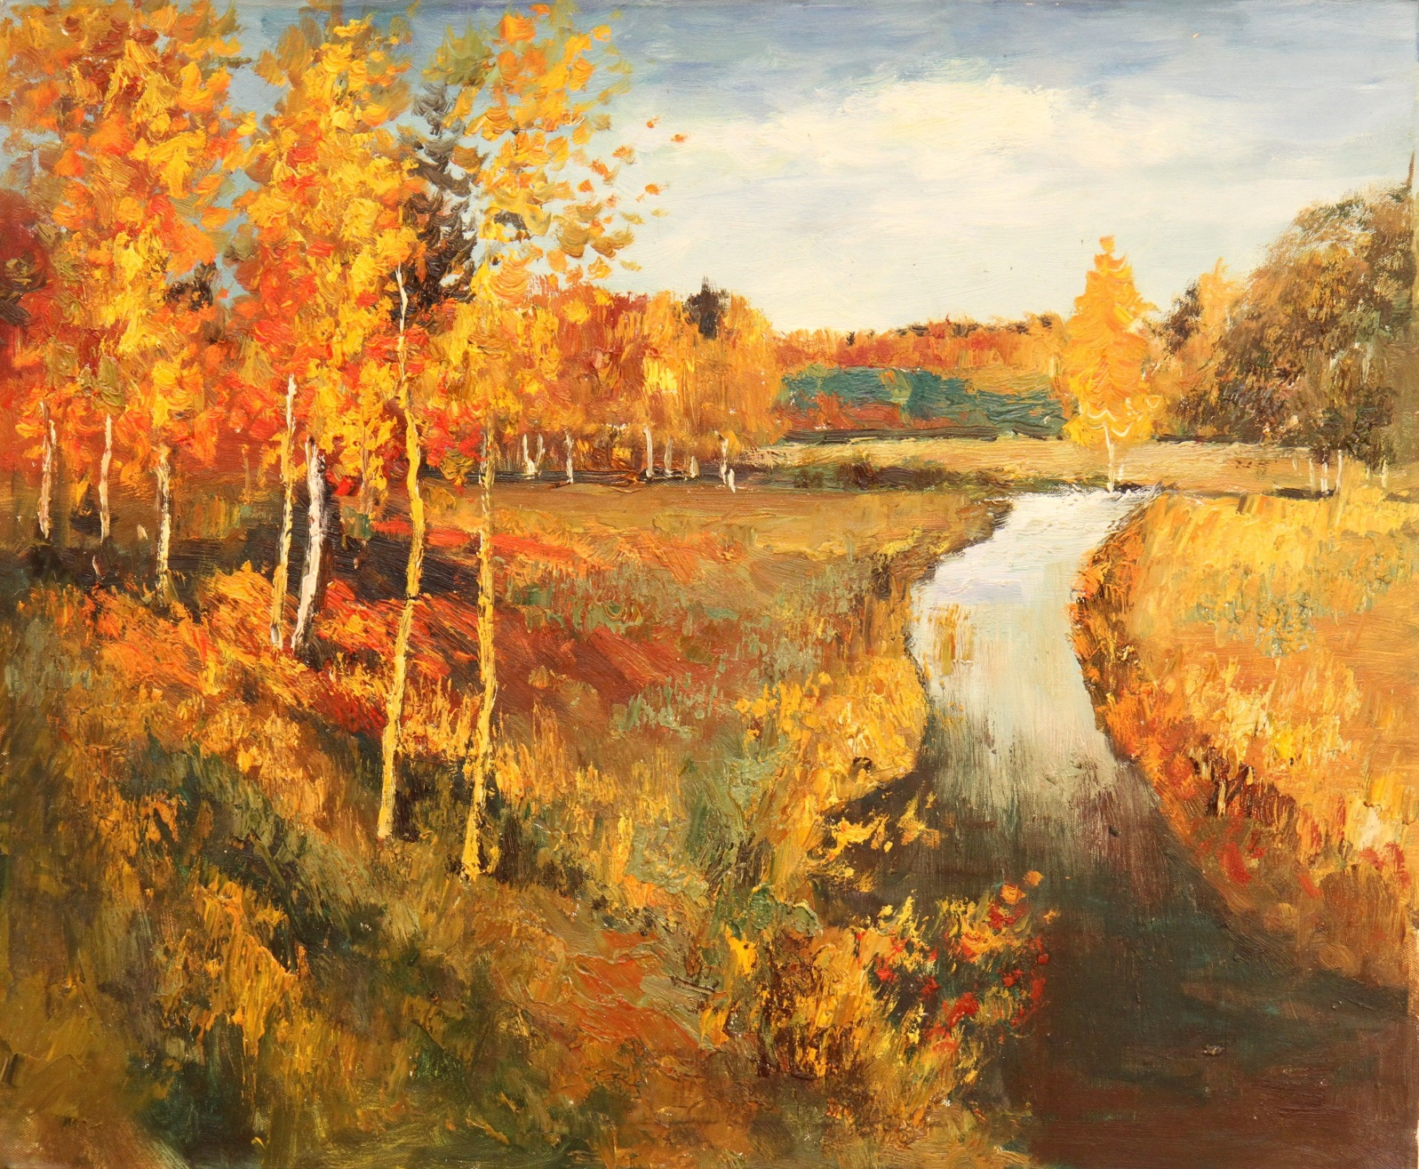
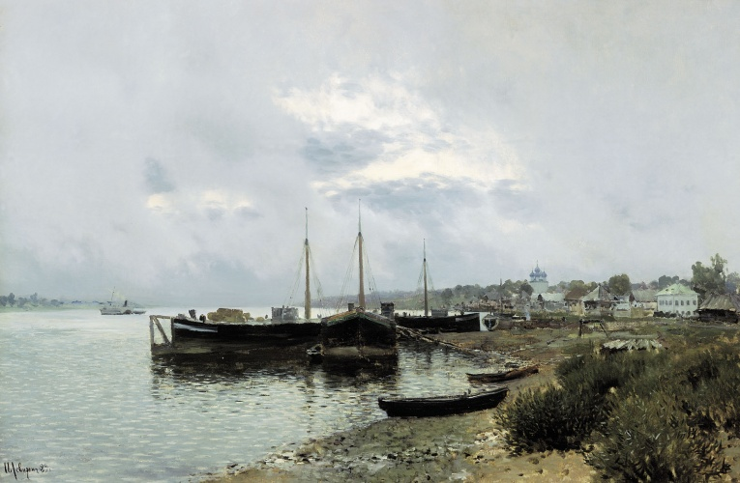
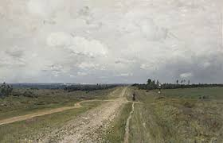
Isaak Levitan

Slide 10
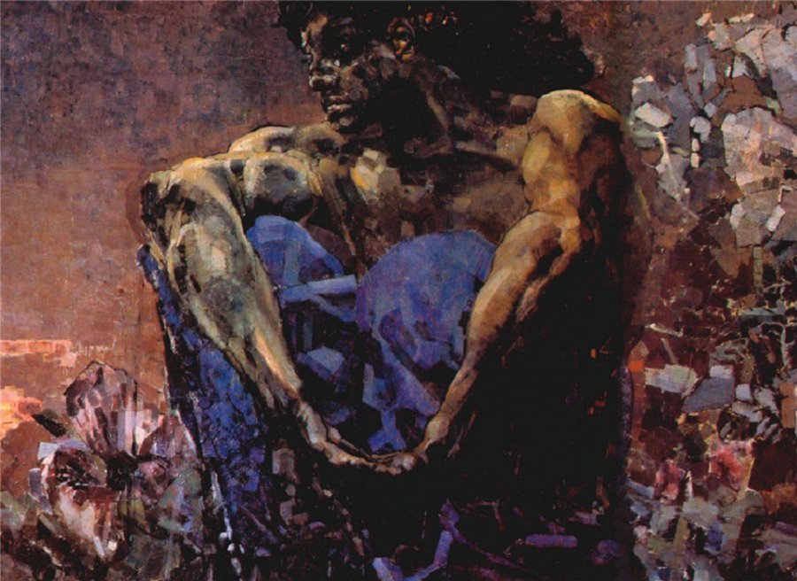
Mikhail Vrubel

Slide 11
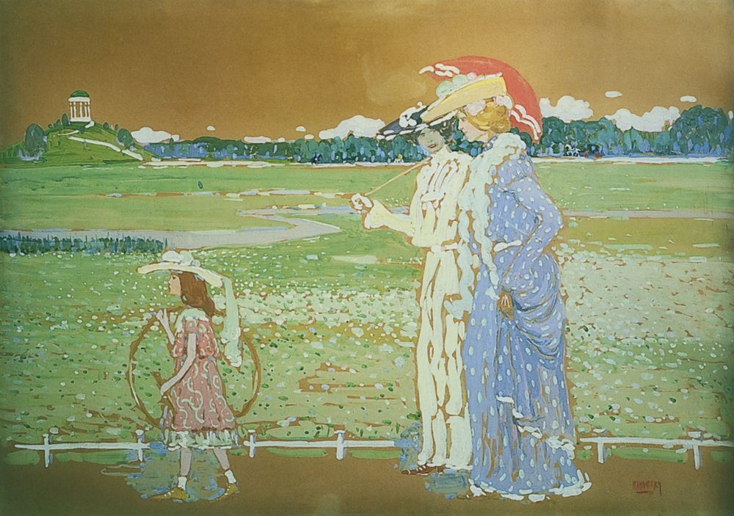
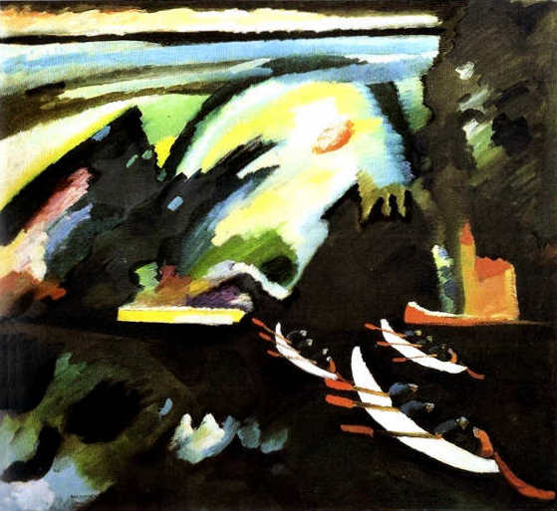
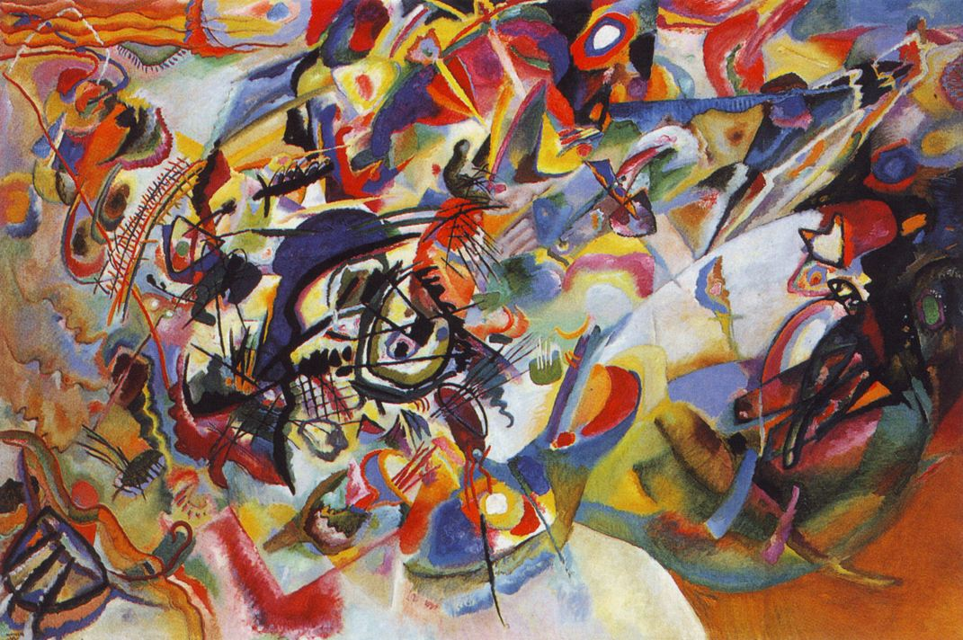
Vasily Kandinsky

Slide 12
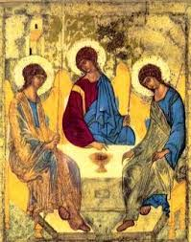
Andrei Rublyov “Trinity”

Slide 13
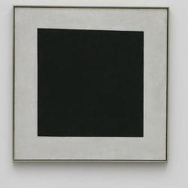
Kazimir Malevitch “Black Square”

Slide 14
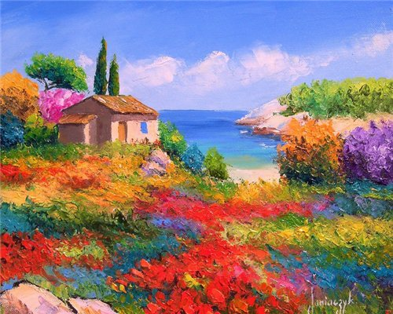
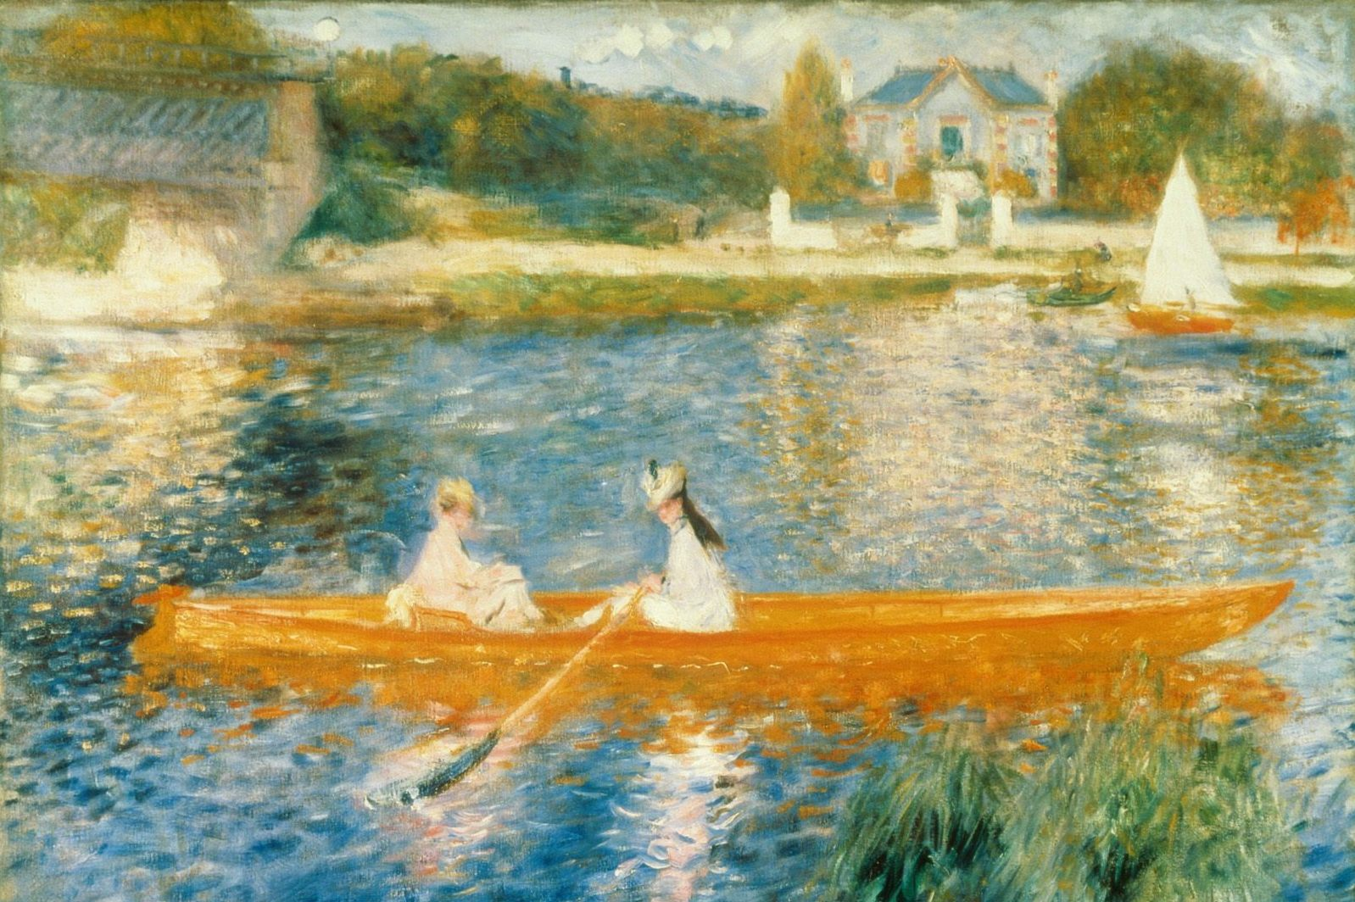
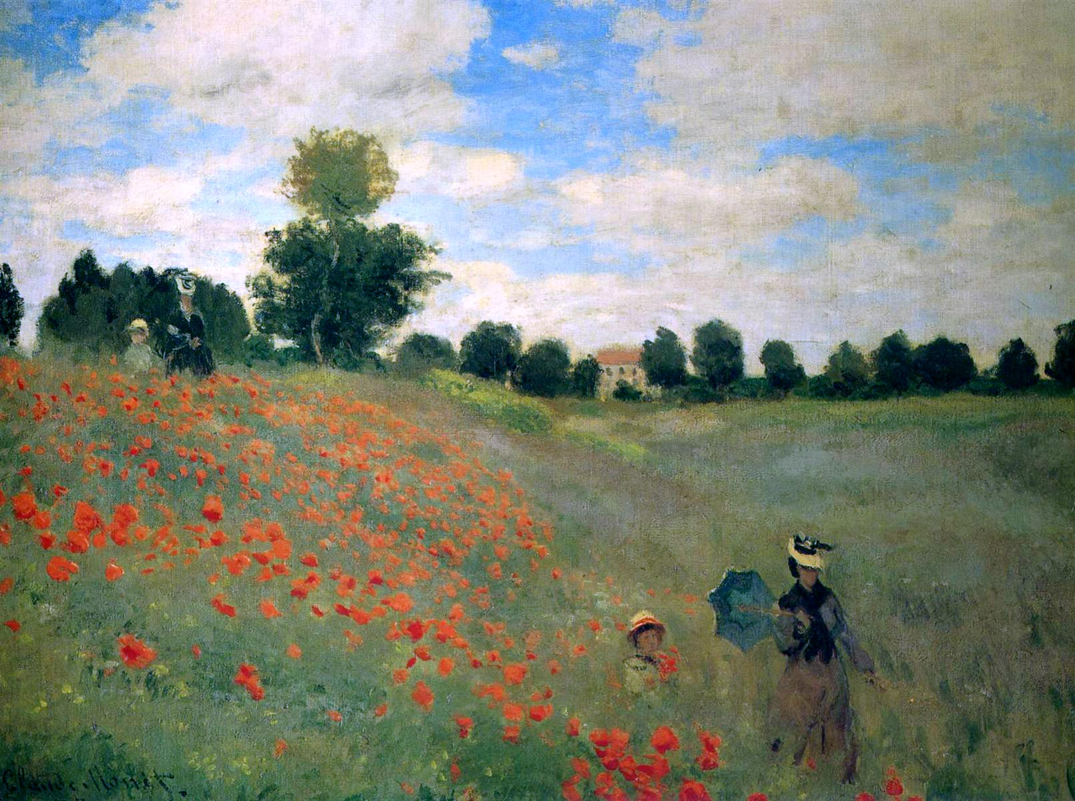
“Art is long and Time is Fleeting” H.W.Longfellow

Slide 15
Thank you for attention!

Slide 16
https://upload.wikimedia.org/wikipedia/commons/thumb/0/06/The_State_Tretyakov_Gallery.jpg/300px-The_State_Tretyakov_Gallery.jpg
https://upload.wikimedia.org/wikipedia/commons/thumb/7/7f/Ilja_Jefimowitsch_Repin_011.jpg/267px-Ilja_Jefimowitsch_Repin_011.jpg
http://idis-moscow.ru/wp-content/uploads/2014/01/Tretyakovskaya-galereya-v-Moskve.jpg
https://encrypted-tbn2.gstatic.com/images?q=tbn:ANd9GcTMNmt-bvseZynBPjHWveLElWDM-OXpmzgL0Em_p-U7H8OVm3BVgQ
http://dic.academic.ru/pictures/wiki/files/87/Wiktor_Michajlowitsch_Wassnezow_004.jpg
http://lingvostranovedcheskiy.academic.ru/pictures/lingvostranovedcheskiy/120-233_(128-241)_img_177.jpg
https://encrypted-tbn1.gstatic.com/images?q=tbn:ANd9GcRRPVIlOH5zAKJM4zb23i8kSHVo6QDuJ51DyL2eQt8eAN1vfJ9QyQ
https://upload.wikimedia.org/wikipedia/commons/thumb/c/c7/Surikov_streltsi.jpg/420px-Surikov_streltsi.jpg
http://mirsoch.ru/uploads/posts/2014-01/1389443374_kartina-i.e.-repina-burlaki-na-volge.jpg
http://ya-uznayu.ru/media/k2/items/cache/47674e109b85ae6495880f2604f34f58_XL.jpg
https://upload.wikimedia.org/wikipedia/commons/thumb/f/fa/Vladimirka_without_frame.jpg/380px-Vladimirka_without_frame.jpg
http://xn----8sbiecm6bhdx8i.xn--p1ai/sites/default/files/Levitan_Zolotay_osen.jpg
https://upload.wikimedia.org/wikipedia/commons/thumb/9/9f/Vrubel_Demon.jpg/425px-Vrubel_Demon.jpg
https://upload.wikimedia.org/wikipedia/commons/thumb/1/17/Andrej_Rubl%C3%ABv_001.jpg/240px-Andrej_Rubl%C3%ABv_001.jpg
https://upload.wikimedia.org/wikipedia/commons/thumb/4/47/Malevich,_Kazimir_Severinovich_-_Black_Square.jpg/250px-Malevich,_Kazimir_Severinovich_-_Black_Square.jpg
https://encrypted-tbn1.gstatic.com/images?q=tbn:ANd9GcSKGdZjT9ucAUerMh6HfyVBUkEuka18UZ4gJe7mjlAtfykzT1_V

